Slide 1
Results Obtained
Action | Precision | Recall | F1-score
Boxing | 0.85 | 0.82 | 0.84
Clapping | 0.94 | 0.99 | 0.97
Hitting bottle | 0.74 | 0.78 | 0.76
Hitting stick | 0.78 | 0.81 | 0.79
Jogging fb | 0.85 | 0.89 | 0.87
Jogging side | 0.90 | 0.92 | 0.91
Kicking | 0.86 | 0.90 | 0.88
Running fb | 0.60 | 0.30 | 0.40
Running side | 0.81 | 0.76 | 0.78
Stabbing | 0.82 | 0.75 | 0.78
Walking fb | 0.80 | 0.92 | 0.86
Walking side | 0.92 | 0.90 | 0.91
Waving hands | 0.99 | 0.95 | 0.97

Slide 2
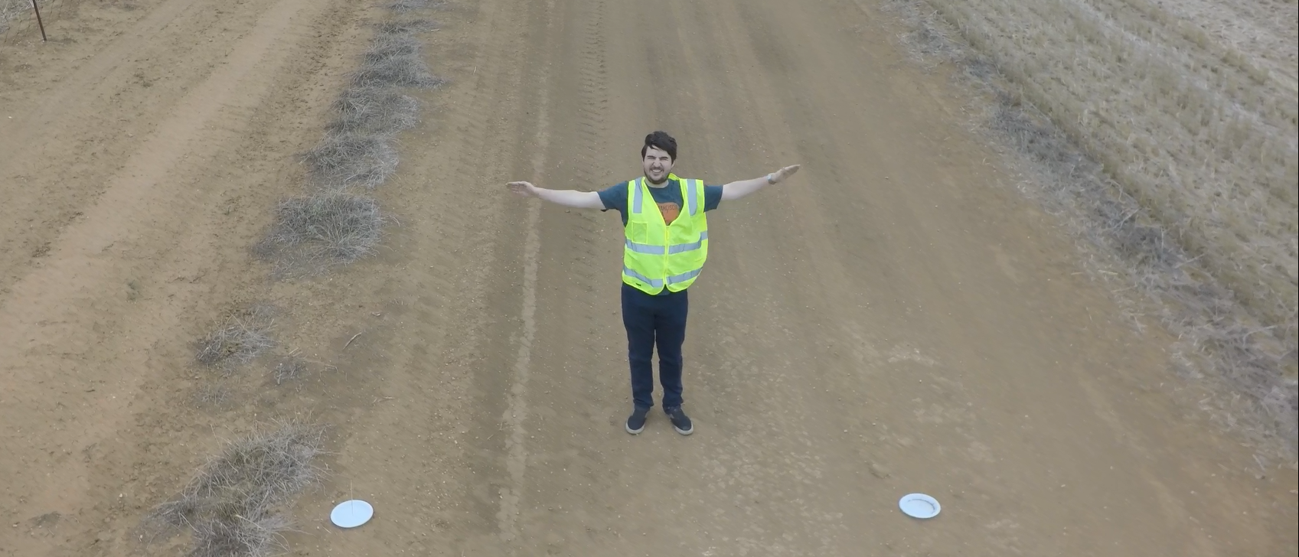
Original Frame from The Dataset

Slide 3
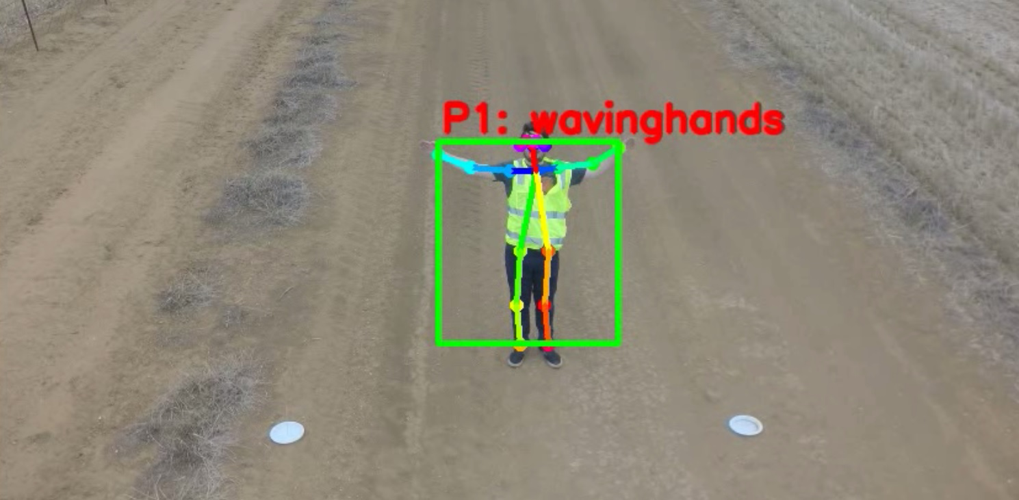
Output

Slide 4
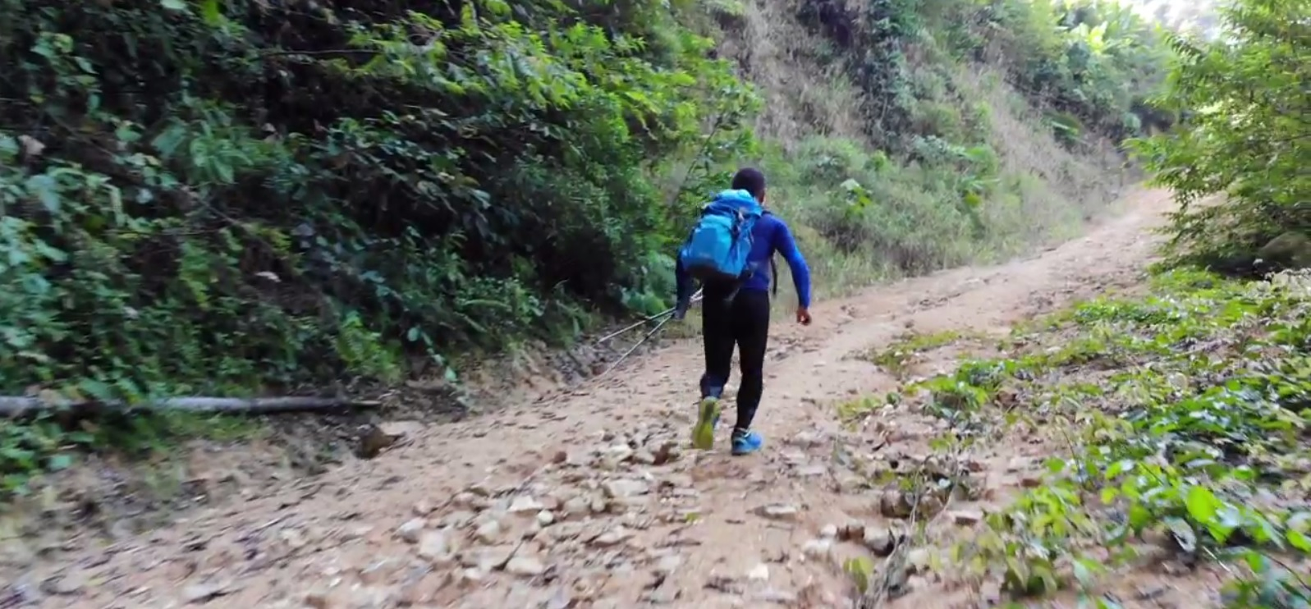
Original Frame from You Tube Video

Slide 5
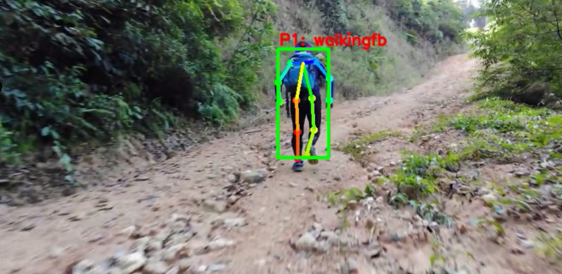
Output

Slide 6
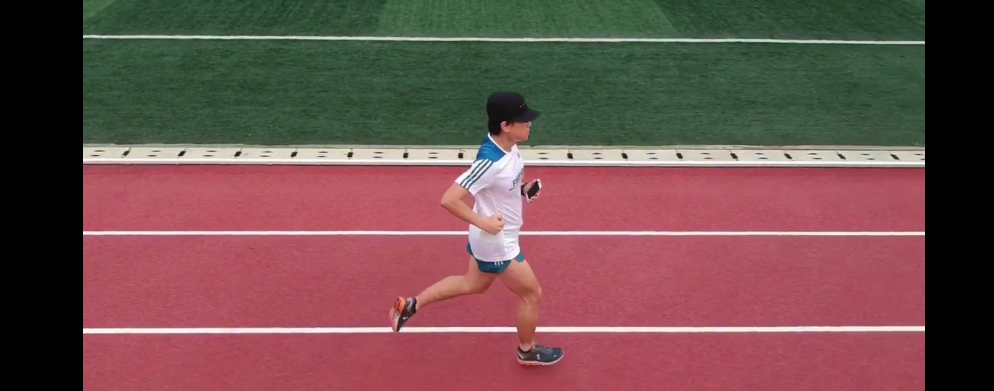
Original

Slide 7
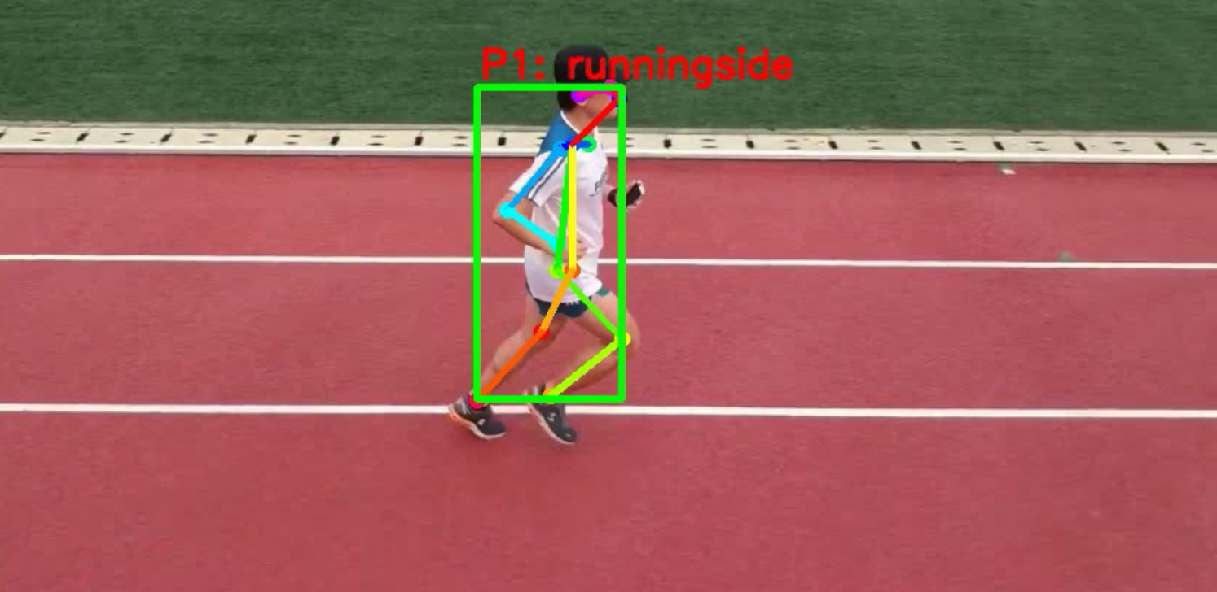
Output

